Slide 1
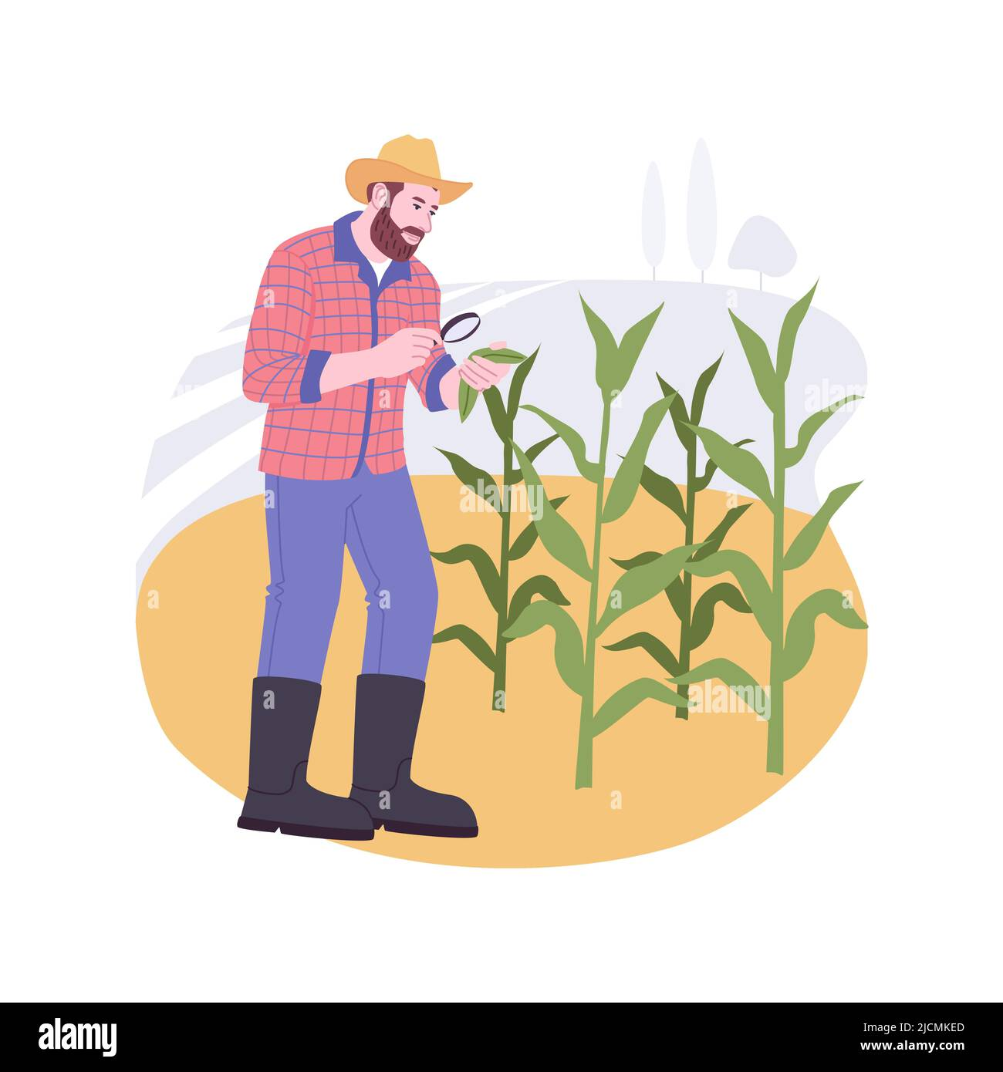
PlantGuard: AI Disease Detection & Real-Time Plant Advice
~By
Sridhar Kandi
Abishek Challa

Slide 2
Introduction
Plant Disease Challenge: Plant diseases significantly impact agricultural productivity, posing challenges for farmers and plant enthusiasts.
Traditional Methods: Existing identification methods are time-consuming, require expert knowledge, and are often inaccessible in real-world scenarios.
AI/ML Solutions: Artificial Intelligence and Machine Learning provide innovative approaches to detect and manage plant diseases efficiently.
Project Focus: This project leverages CNNs for disease classification and integrates LLMs to deliver actionable, disease-specific advice.

Slide 3
Objective
Develop an Automated System: Build an AI/ML-powered tool to detect plant diseases using image classification
1
Model Performance Comparison: Evaluate and compare the effectiveness of CNN and ResNet architectures on the PlantVillage dataset.
2
Actionable Disease Advice: Integrate a Large Language Model (LLM) to provide tailored recommendations, including treatment options and preventive measures.
3
Enhance Accessibility: Create a user-friendly interface for farmers, gardeners, to easily diagnose and manage plant health.
4

Slide 4
Dataset and Preprocessing
Dataset:
Used PlantVillage dataset which has 54,306 images across 38 classes (healthy and diseased plants).
Includes a variety of crops such as tomatoes, potatoes, and corn.
Challenges:
The dataset features simple, controlled backgrounds, which may limit generalization to real-world environments.

Slide 5
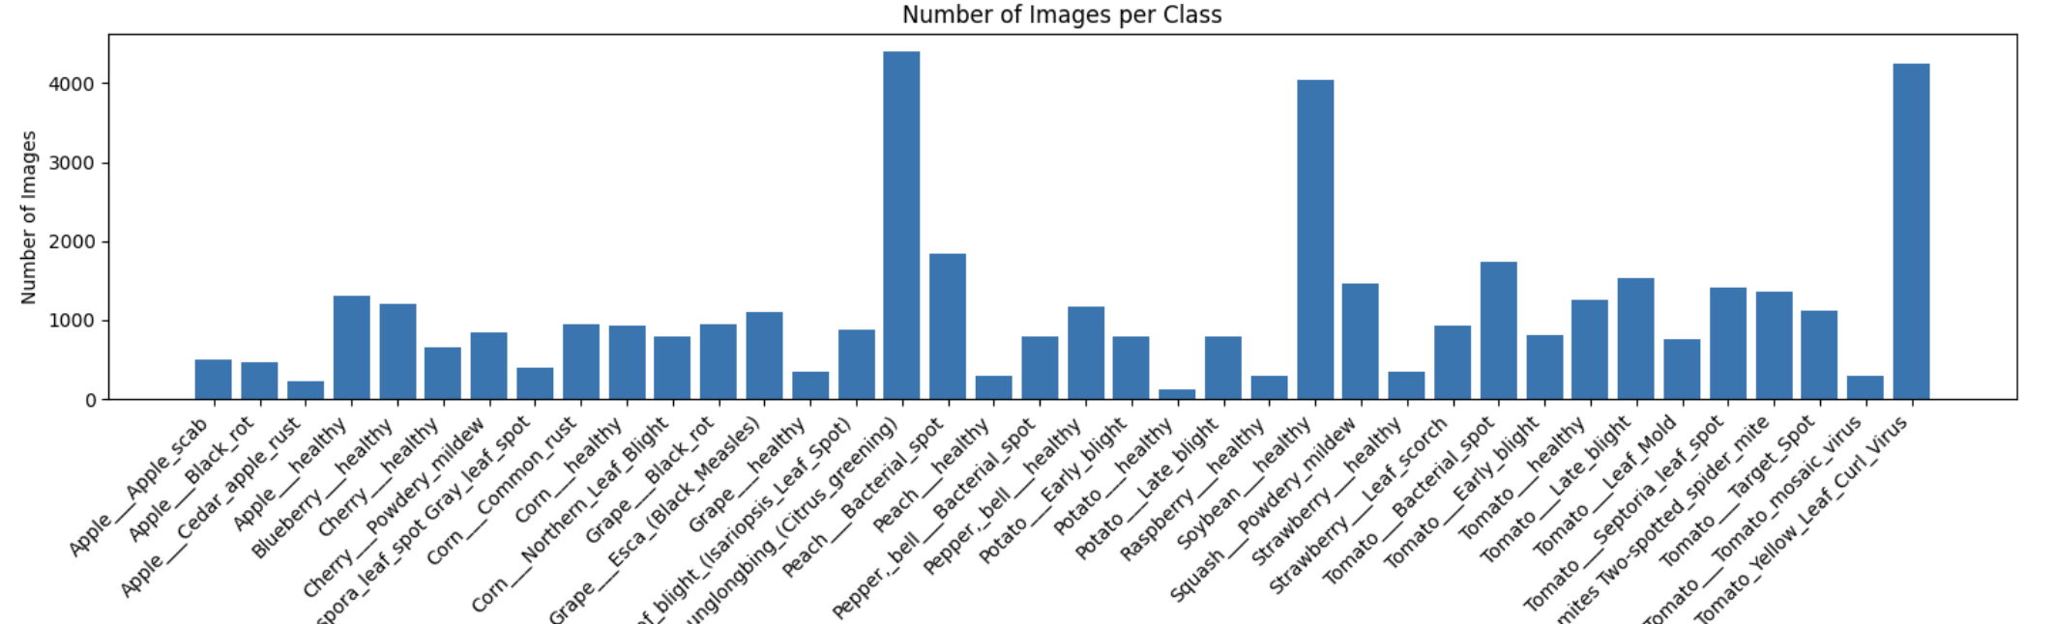
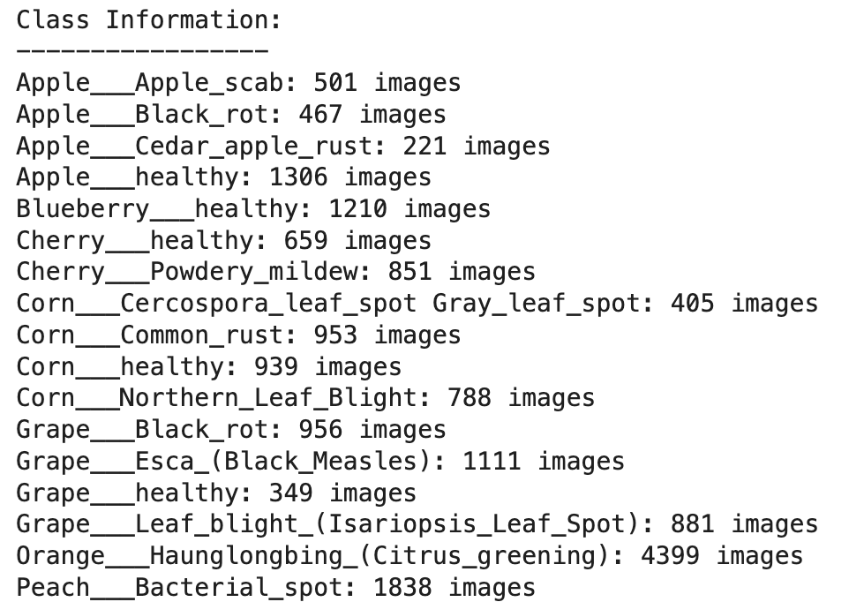
Dataset and Preprocessing

Slide 6
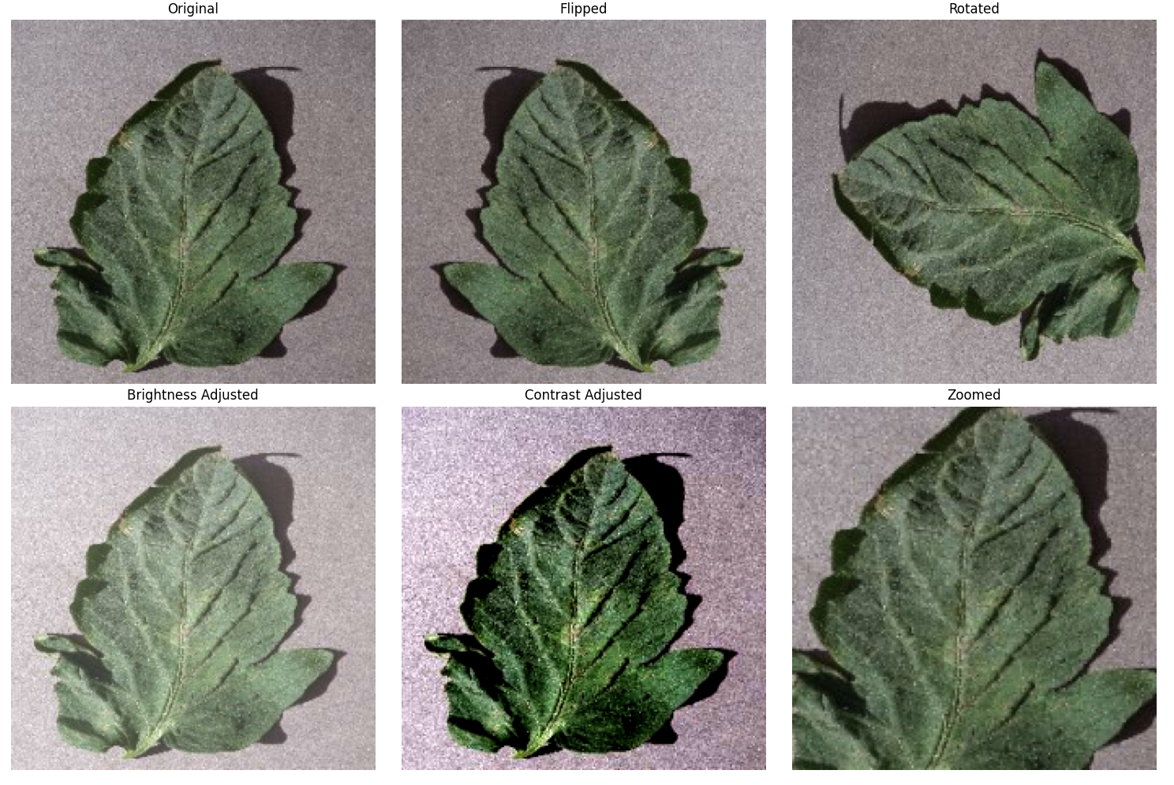
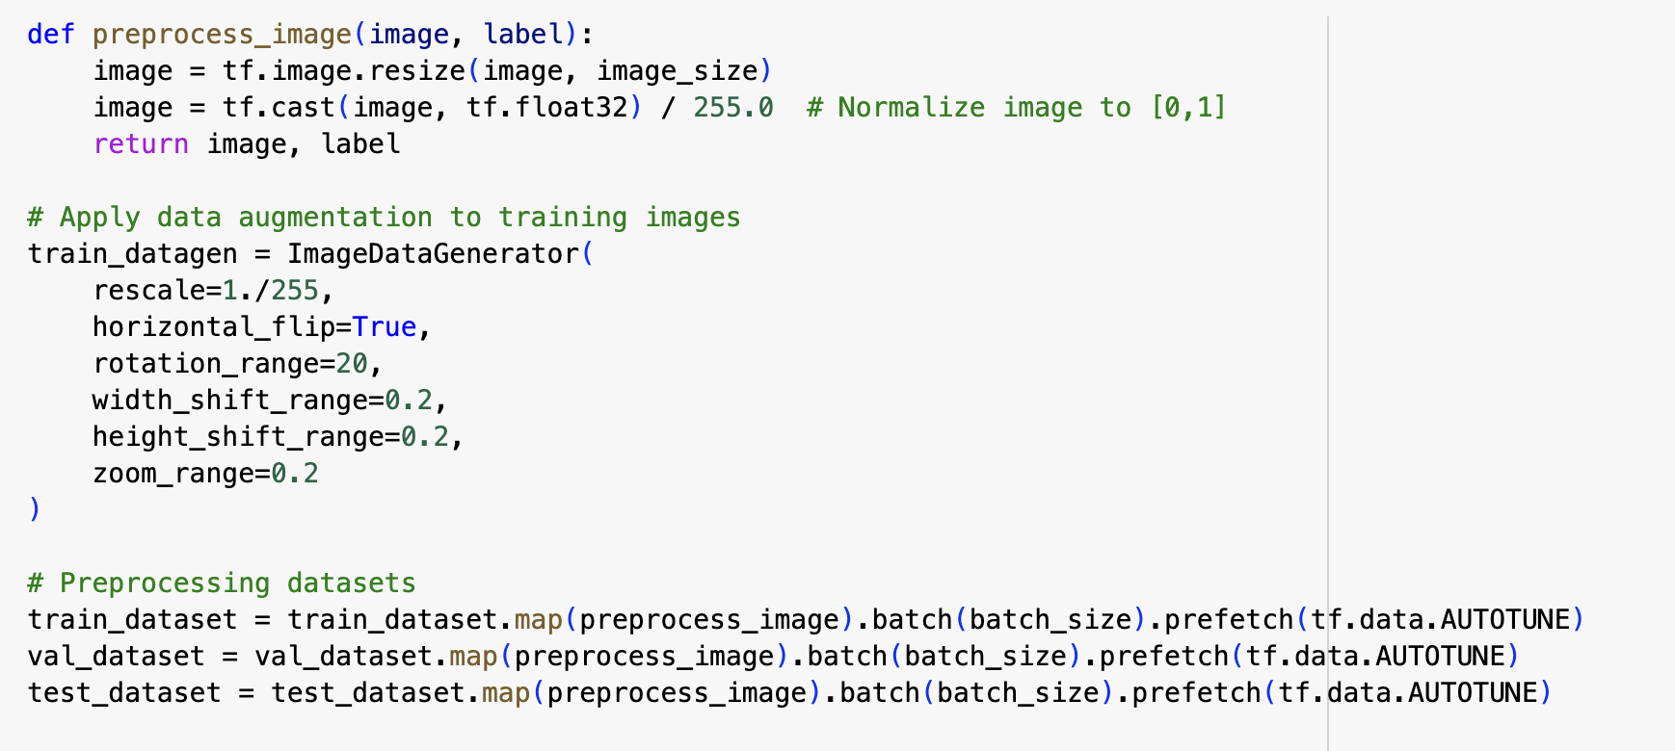
Data Augumentation

Slide 7
Key Components and Technologies
CNNs & ResNet50: Custom architecture and transfer learning for precise plant disease classification.
TensorFlow & Keras: Deep learning frameworks for model training and optimization.
Hugging Face Transformers: Embedded agricultural knowledge for contextual understanding.
FAISS & OpenAI GPT-4: Efficient info retrieval and natural-language query responses.
Streamlit: User-friendly interface for image uploads and interactive query handling.

Slide 8
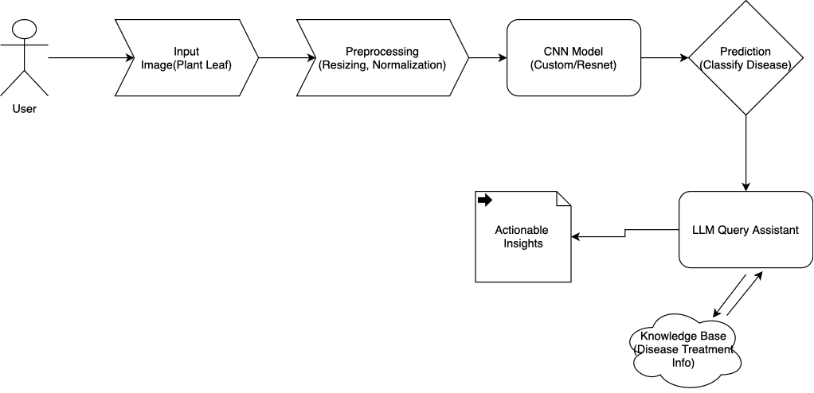
Workflow

Slide 9
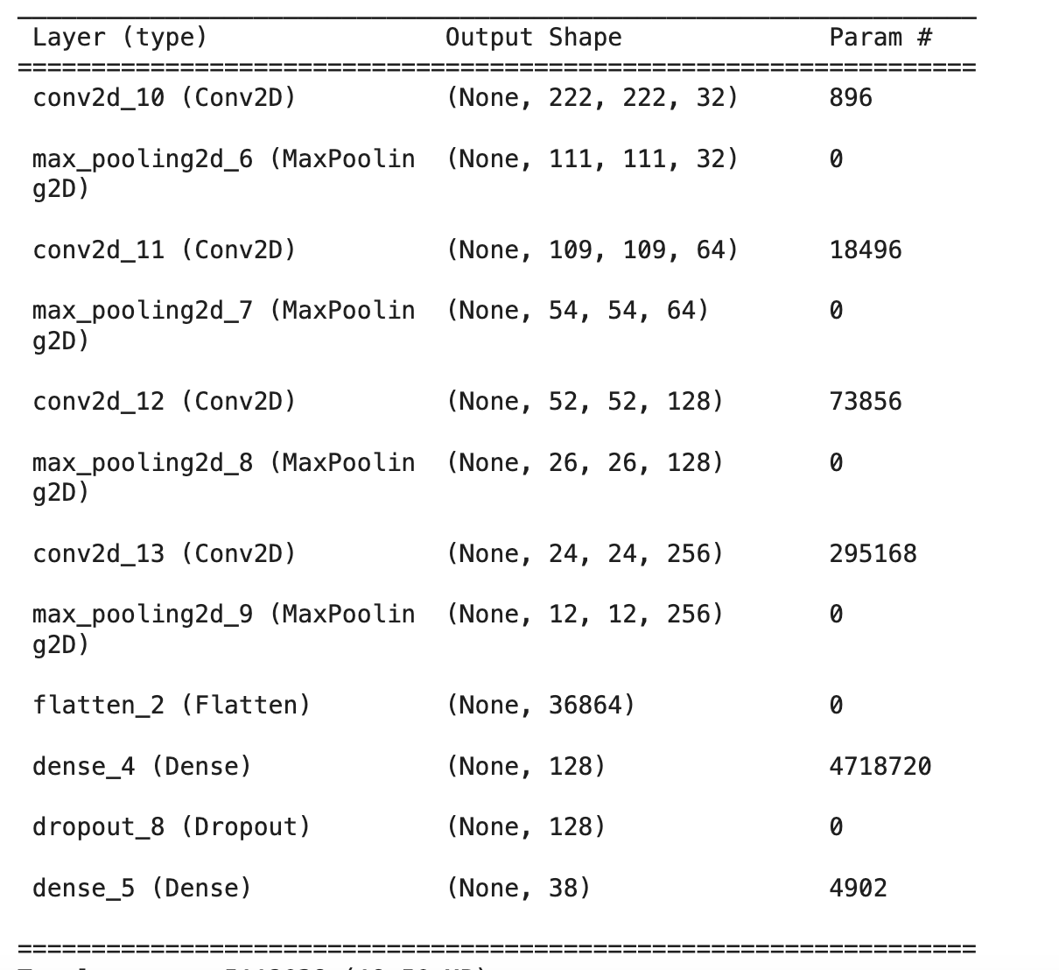
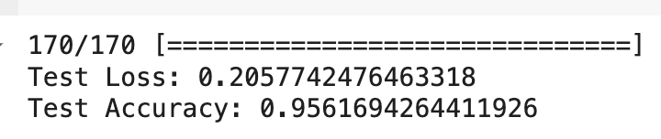
CNN Model

Slide 10
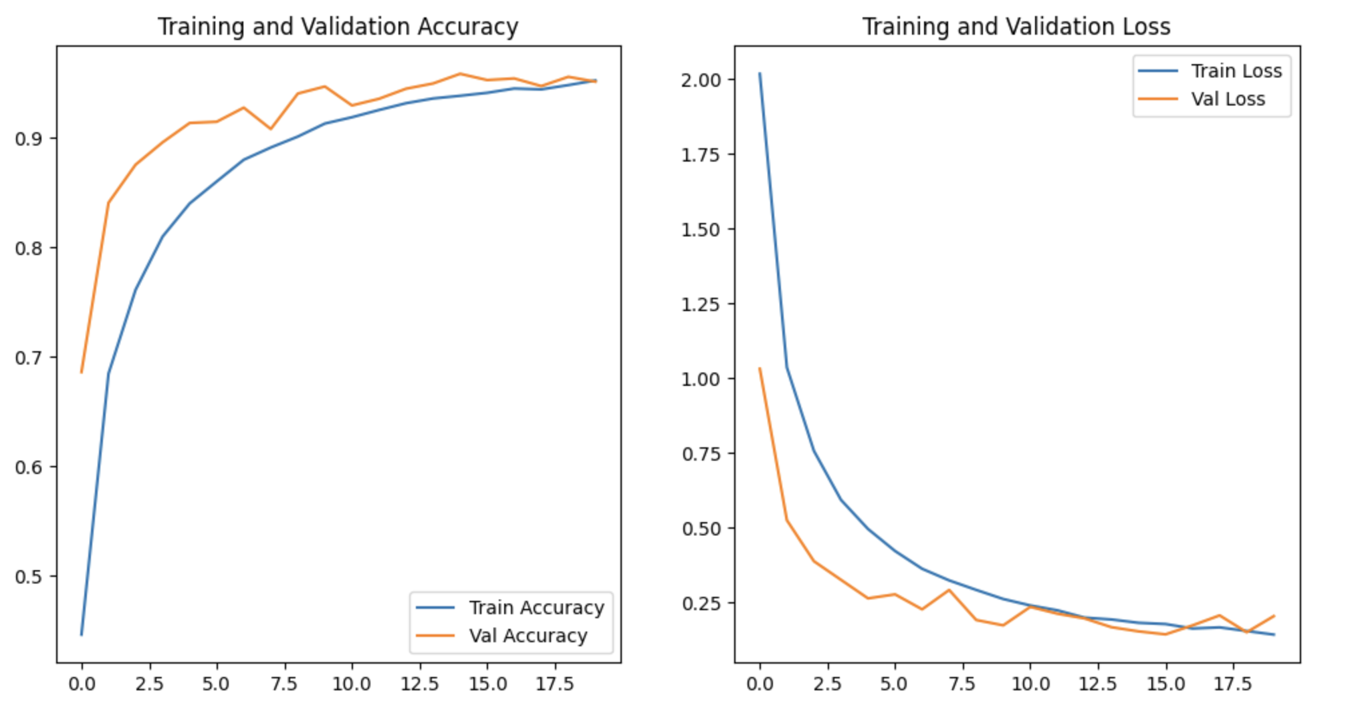
CNN Training vs Validation Accuracy

Slide 11
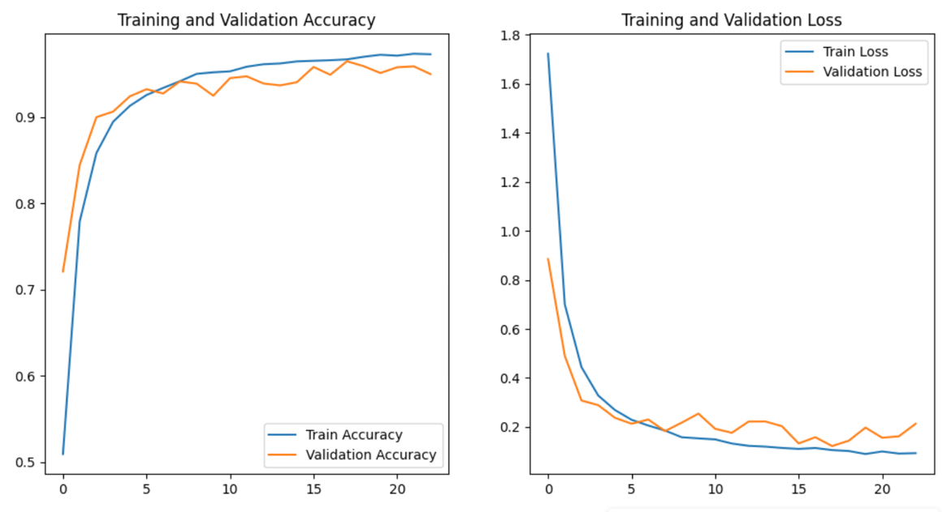
UPDATED CNN: Training vs Validation Accuracy

Slide 12
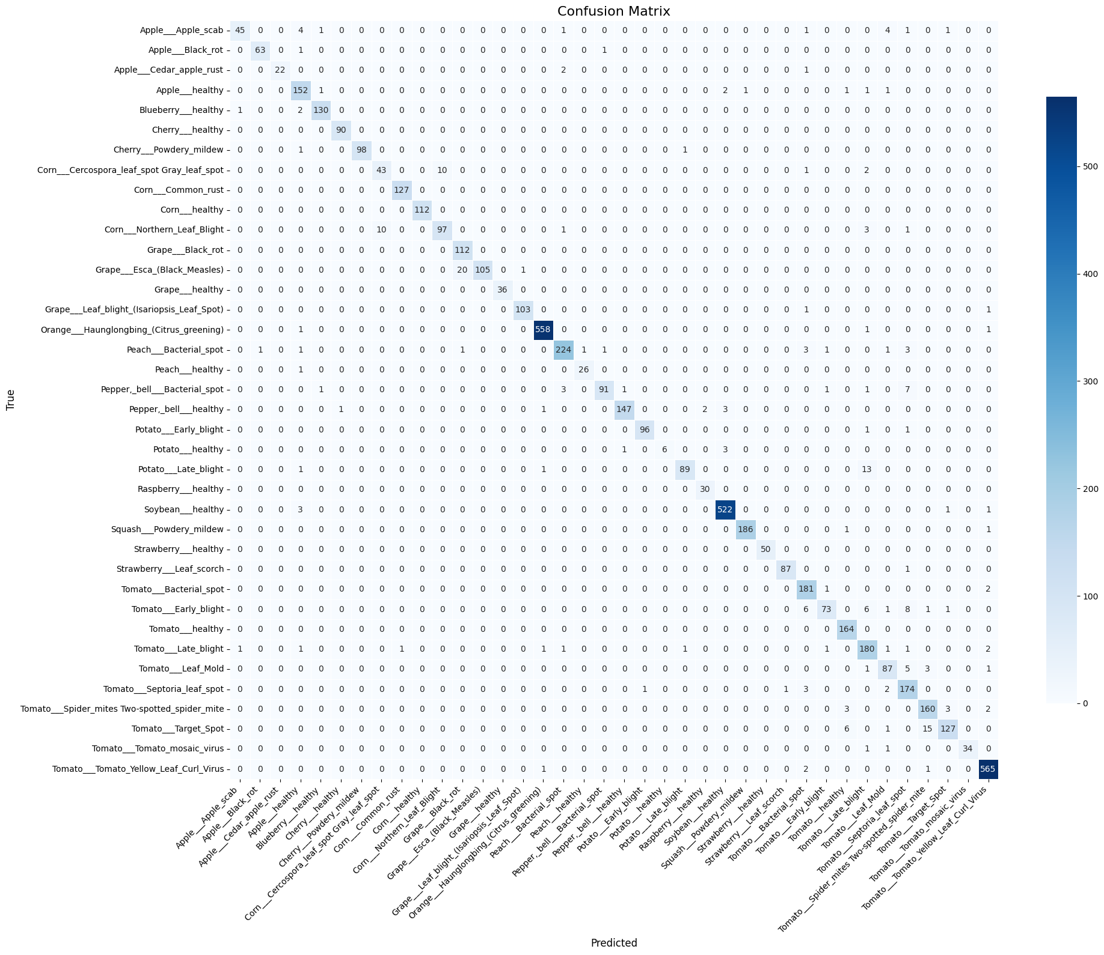
Confusion Matrix

Slide 13
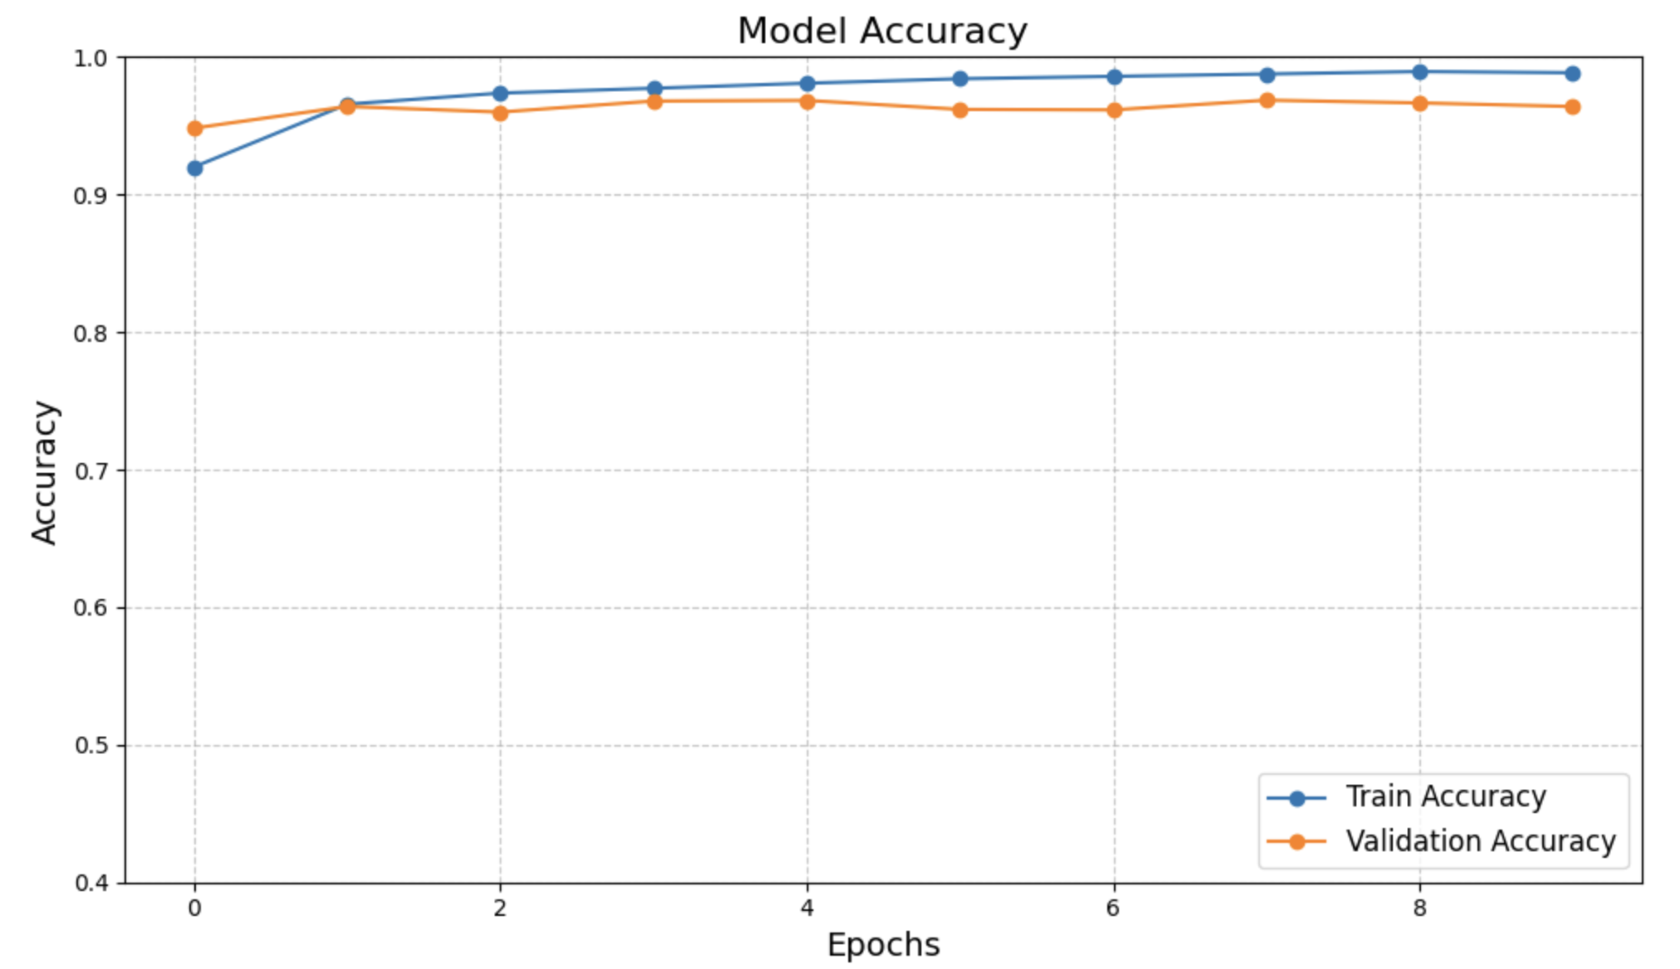
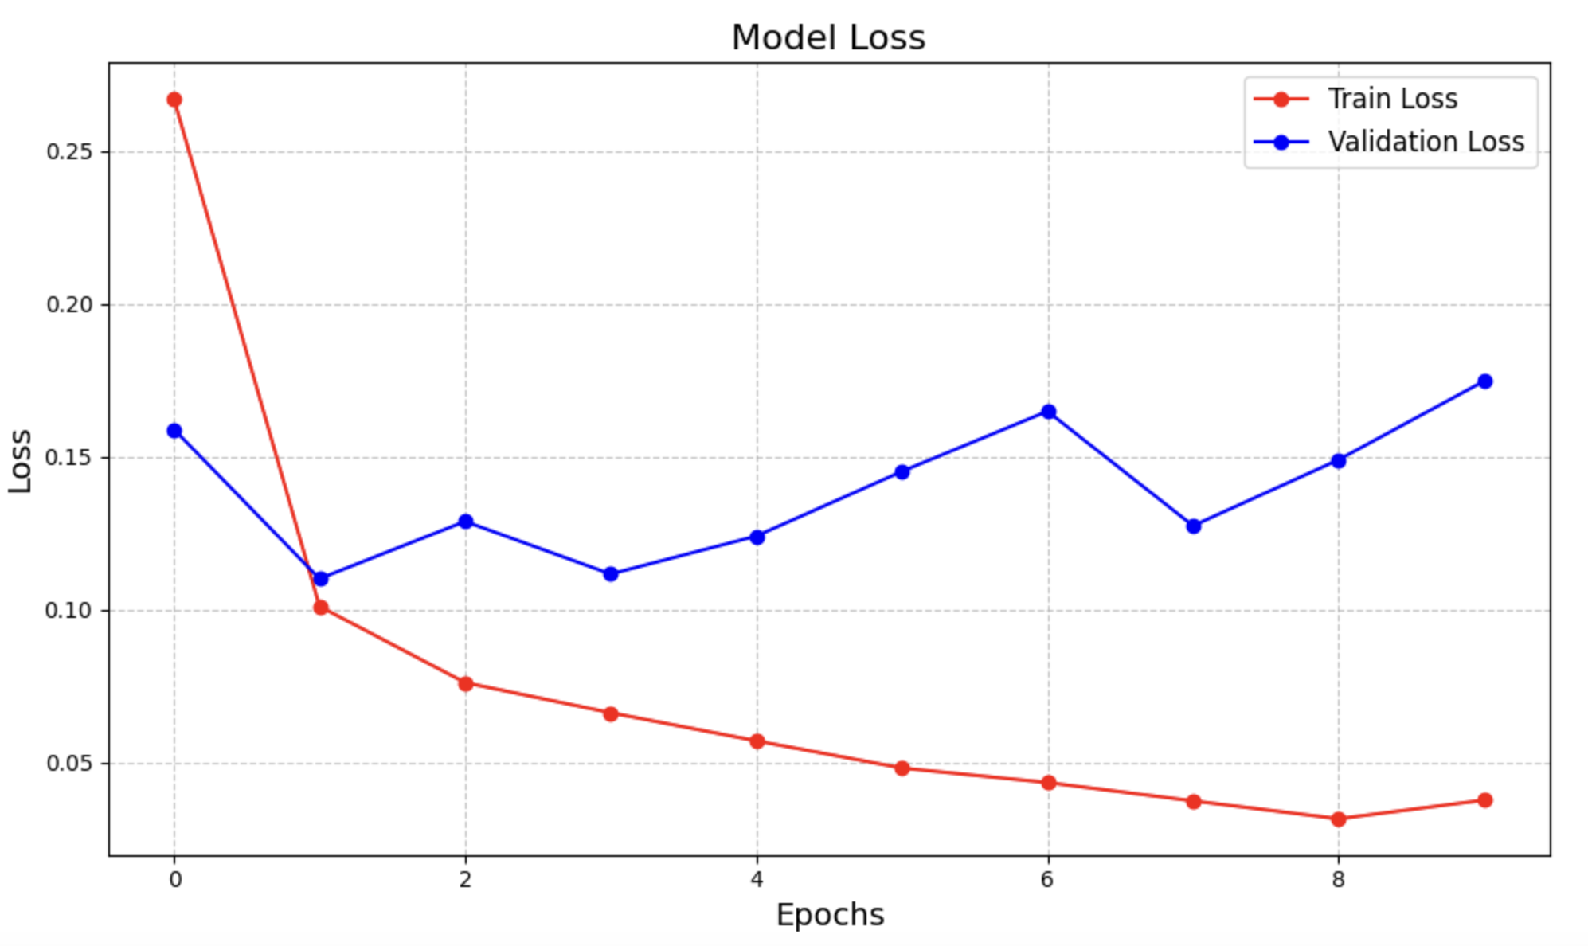
Resnet-50

Slide 14
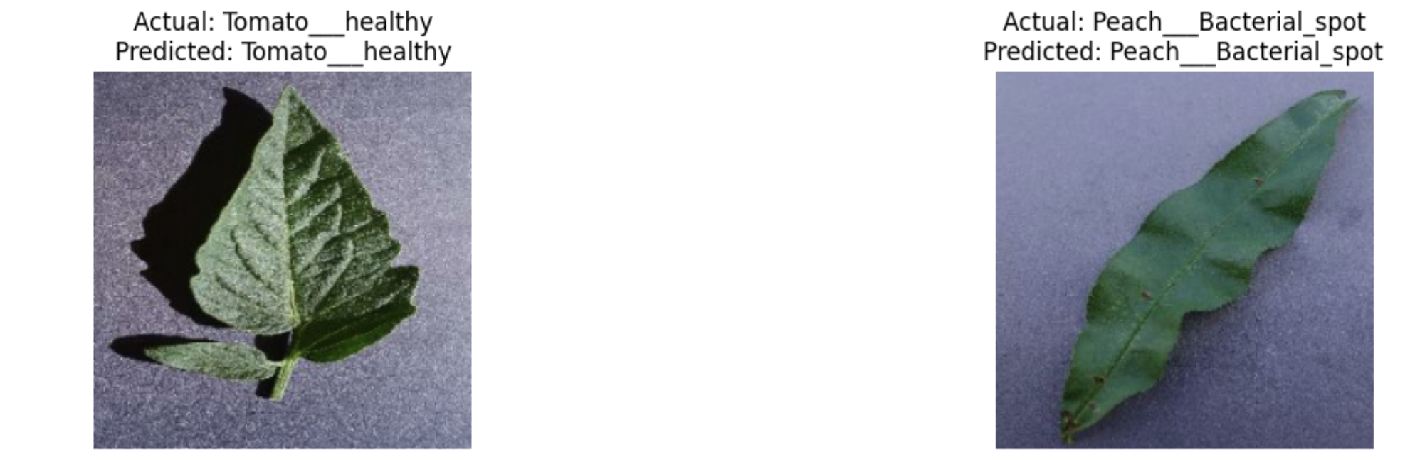
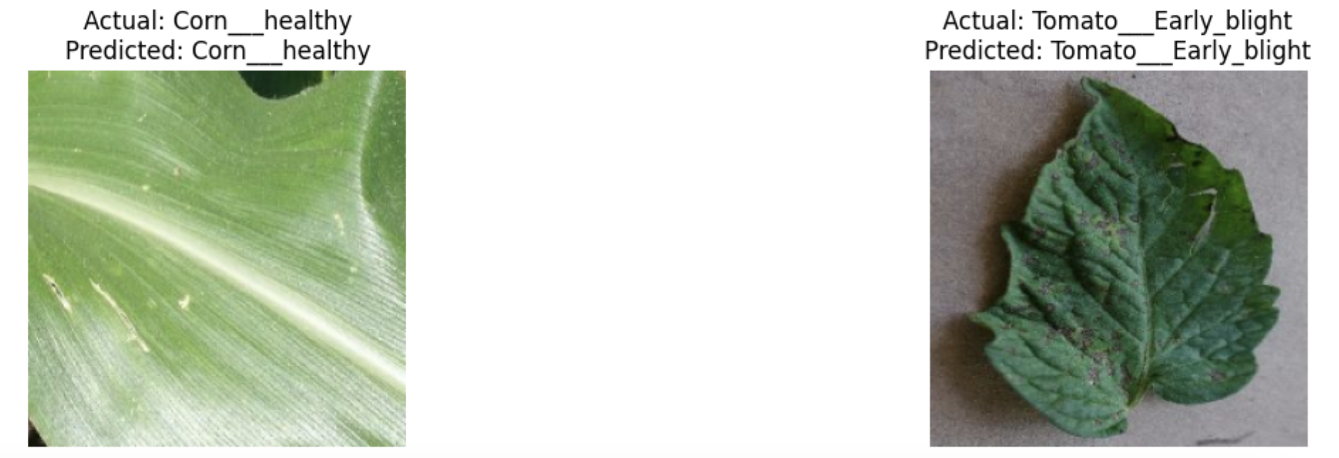
Results

Slide 15
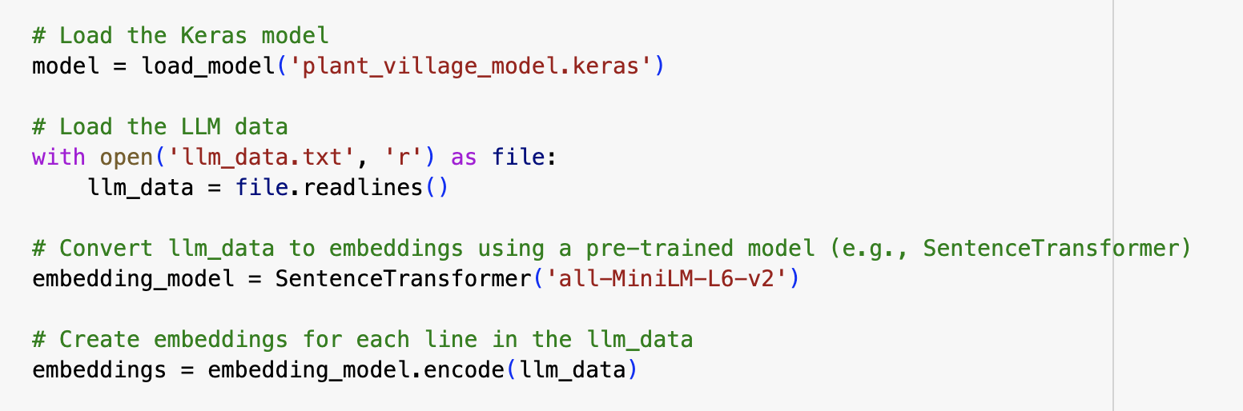
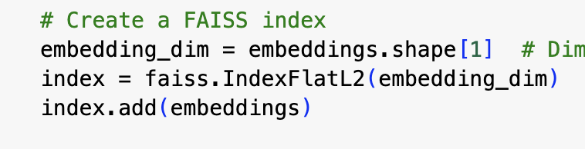
LLM Integration with CNN Model

Slide 16
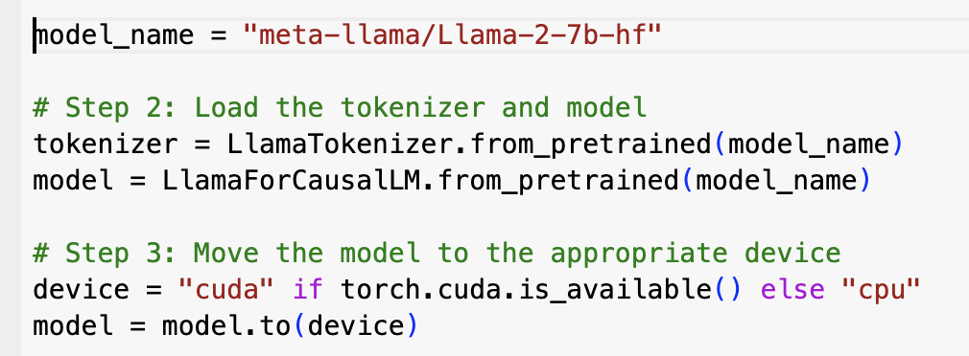
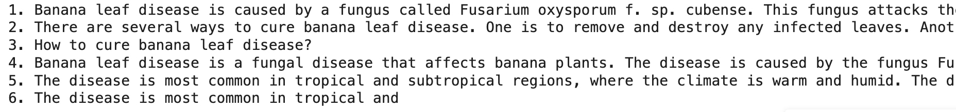
Llama
Question to Llama: How to cure banana leaf disease?

Slide 17
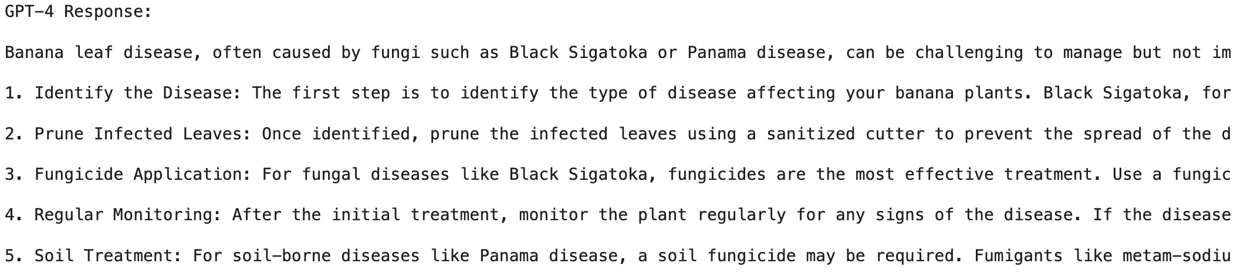
GPT
Same Question to GPT: How to cure banana leaf disease?

Slide 18
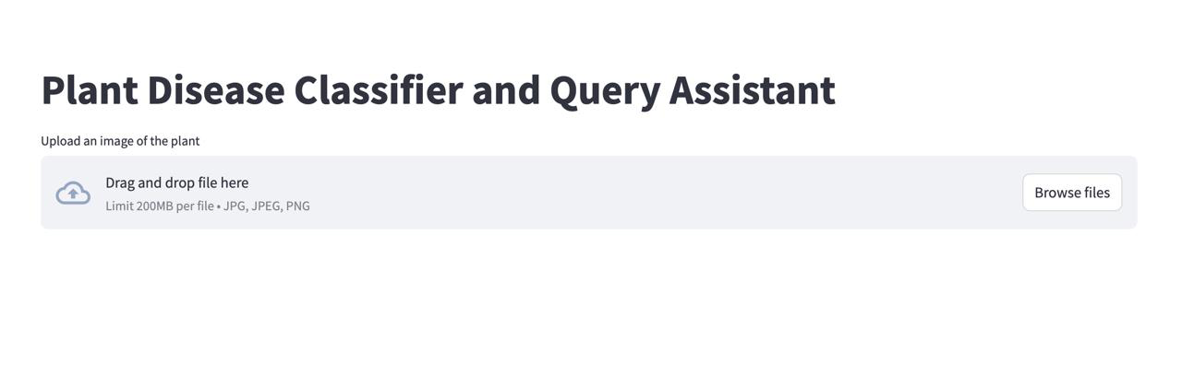
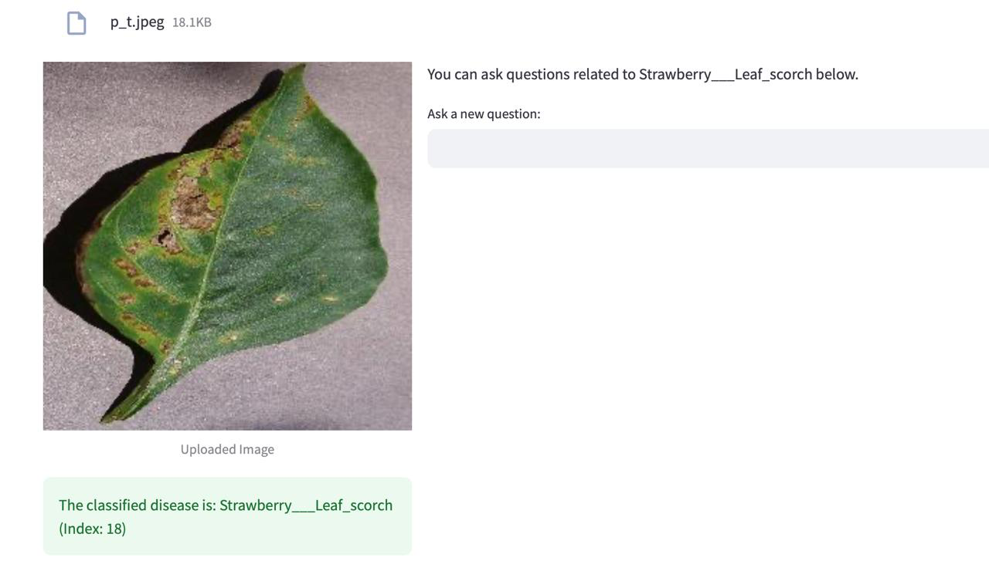
Final Results

Slide 19
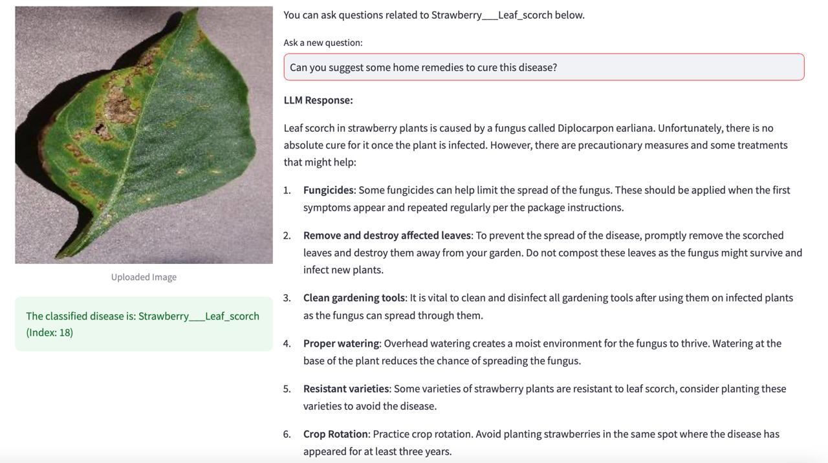
Final Results

Slide 20
Conclusion
Successfully integrated CNN models for plant disease classification and LLM models for query assistance, creating a comprehensive system for agriculture.
Achieved high-precision disease detection for 38 plant diseases using CNN models, including ResNet50.
Enabled detailed, disease-specific recommendations and treatments through GPT-4-powered query responses.
Enabled image-based classification and natural language queries for accessible and practical use.

Slide 21
Future Scope
Explore advanced architectures like Vision Transformers (ViT) and EfficientNet for enhanced performance.
Enable real-time disease detection on mobile devices and edge systems.
Expand dataset coverage and enhance LLM with region-specific practices and multilingual support.
Adapt the framework for other domains, such as animal health or human diagnostics.

Slide 22
THANK YOU
😊

